Slide 1
APUSH Review: Key Concept 6.1, revised edition
EVERYTHING YOU NEED TO KNOW ABOUT KEY CONCEPT 6.1 TO SUCCEED IN APUSH!

Slide 2

KEY CONCEPT 6.1
“Technological advances, large-scale production methods, and the opening of new markets encouraged the rise of industrial capitalism in the United States.”
Page 67
Big Idea Questions:
What was the relationship between businesses and government?
In what ways did the South change and remain the same? (Change and Continuity over time)
How did farmers and industrial workers respond to corporations?

Slide 3
KEY CONCEPT 6.1, I
“Large-scale industrial production - accompanied by massive technological change, expanding international communication networks, and pro-growth government policies - generated rapid economic development and business consolidation.” - page 67
A) How were new markets opened in North America after the Civil War?
Government provided $ and land for construction of RRs
Pacific Railway Acts
Telegraph lines were often linked with railroads
Impacts of subsidies?
Growth of farms, cities, lumber industry

Slide 4
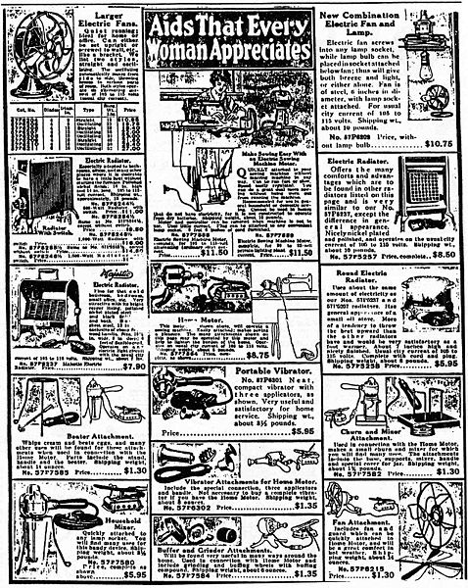
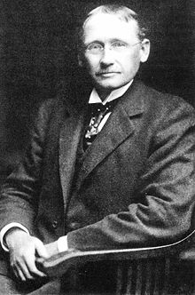
KEY CONCEPT 6.1, I
B) Businesses increased the production of goods by:
Technological advances:
“Taylorism” - Frederick Taylor - focused on improving efficiency - timed tasks, specific tasks for workers
Greater access to natural resources - lumber
Redesigned financial and management structures:
Monopolies - businesses sought to have sole control over an industry
Marketing advances:
Mail order catalogs - Sears - appealed to middle-class families
Growing labor force:
Large supply of workers

Slide 5
KEY CONCEPT 6.1, I
C) Impact of the Industrial Revolution?
Price of goods decreased and workers’ wages increased
New goods and services emerged - sewing machines, sporting equipment, other household items
Americans’ standards of living improved
However, a gap grew between the rich and poor
D) Business leaders sought to increase profits by consolidating businesses into:
Trusts - associated with monopolies
Holding companies - one company that owns stock in several other companies, thus controlling them
E) Businesses and policymakers sought markets and resources in:
Pacific Rim - Hawaii - calls for annexation in the 1890s (sugar)
Asia - Philippines - gained in 1898 (Spanish American War)
1899 - Open Door Policy in China - US sought to trade freely with China
Latin America - “Big Brother” policy - James G. Blaine
Opened up markets to the US

Slide 6
KEY CONCEPT 6.1, II
“A variety of perspectives on the economy and labor developed during a time of financial panics and downturns.” - page 68
A) Laissez-faire (Government would keep its “hands off” the economy):
Became a dominant economic philosophy, very little government regulation of industries
B) Expansion of industrial workforce:
Internal migration - farmers moved to cities to work in factories
International migration - “New” Immigration, predominantly Southern and Eastern Europe, China as well
Child labor increased - many families relied on children for wages
Huge supply of workers led to lower wages

Slide 7
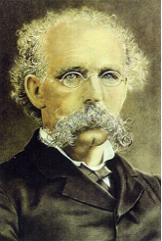
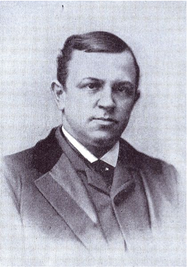
KEY CONCEPT 6.1, II
C) Labor vs. Management:
Battled over wages and working conditions
Local and national unions emerged to confront businesses
Knights of Labor - Terrance Powderly - skilled AND unskilled workers, women, and African Americans; downfall was the Haymarket Square Riot
American Federation of Labor - Samuel Gompers - skilled workers only; focused on “bread and butter issues”
Unions hoped to improve working conditions and wages
D) The South began to industrialize:
Leaders called for a “New South” - Henry Grady, editor of the Atlantic Constitution, called for increased industrialization in the South; textile factories began to appear in the South
Sharecropping and tenant farming remained throughout much of the South:
Payment in land in the form of cash (tenant) or crops (sharecropping)
Many African Americans were sharecroppers throughout the 1800s

Slide 8
KEY CONCEPT 6.1, III
“New systems of production and transportation enabled consolidation within agriculture, which, along with periods of instability, spurred a variety of responses from farmers.” - page 69
A) Increase in agricultural production:
Mechanized tractors, reapers, etc. allowed for less reliance on animals and allowed for faster cultivation of crops
Grain elevators allowed for storing crops and transporting to RRs more easily
The increased production of goods led to a decrease in food prices

Slide 9
KEY CONCEPT 6.1, III
B) How did farmers respond to consolidation in businesses and RRs?
Created local and regional cooperative organizations:
The Grange (1860s): sought to bring farmers together to share techniques
Hoped to elect state legislatures favorable to their programs
Granger laws - state laws that regulated RRs
Southern Farmers’ Alliance: mostly a local organization
Established stores and banks; excluded blacks……
Colored Farmers’ Alliance:
Mostly in the southern US

Slide 10

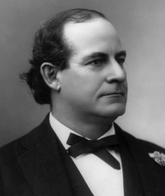
KEY CONCEPT 6.1, III
I ran for president in 1896 as a Populist and Democrat. I advocated “Free Silver”
C) People’s (Populist) Party:
Called for a stronger governmental role in the economic system
Causes:
Growth of corporate power
RRs - high rates hurt farmers
Economic instability - panics of 1873 and 1893 hurt farmers
Goals:
Called for a stronger governmental role in the economic system
Graduated income tax; inflation of currency (help farmers), “free silver”
Political reform - direct election of senators; government ownership of RRs, telephones, and telegraphs

Slide 11
Test Tips
Multiple-Choice and Short Answer:
New business structures and their effects
Role of government during this time
Plight of farmers
Goals of labor unions
Sharecropping
Populist Party
Essays:
Comparing the role of government during this time to other time periods
Ways farmers and laborers responded to corporations

Slide 12
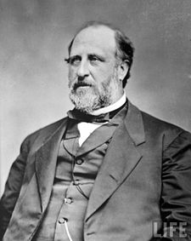
See You Back Here For 6.2!
Thanks for watching
Best of luck in May!

